Slide 1
Identifying and Mitigating Privacy Risks
What is Privacy?
Identify Privacy Risks
Privacy Tradeoffs
Mitigate Privacy Risks

Slide 2
What is Privacy?
Topic A

Slide 3



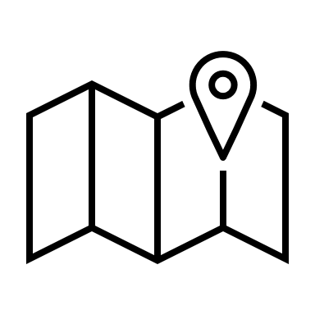

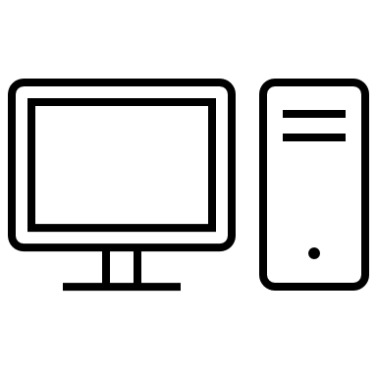
Privacy and Personal Information (Slide 1 of 3)
Privacy: Being free from observation or intrusion of our personal lives by others.
Privacy of behavior
Privacy of the body
Decisional privacy
Privacy of thoughts
Local privacy
Informational privacy

Slide 4
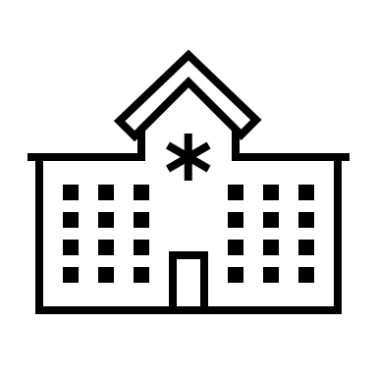
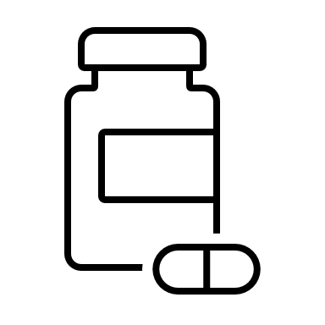
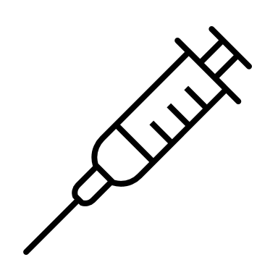

Privacy and Personal Information (Slide 2 of 3)
Informational privacy: The ability to control who has access to our personal information, and to what extent.
Personal information: Any information that can directly or indirectly be linked to someone’s identity.
Risk: personal information may be abused.

Slide 5




Privacy and Personal Information (Slide 3 of 3)
Contextual integrity: An aspect of informational privacy which describes the fact that we're happy for some of our personal information to be known to others in some contexts but not in others.
Example: We're happy for our health and financial data to be accessible to doctors and bank employees, but not criminals.

Slide 6





Privacy and Emerging Technologies
Companies deal with data privacy. Collecting, storing, and using data and information about people responsibly means handling data in accordance with people's interests and expectations.

Slide 7
Privacy and Power
Knowledge of private information equates to power over the subject of the information.
Protecting privacy enables people to be themselves without fear of influential behavior due to monitoring.
Examples of privacy violations:
2013: Snowden’s whistleblowing
2019: China’s social credit system

Slide 8


Privacy in Different Cultures
Value of privacy depends on cultural norms.
Western cultures often focus on individual privacy.
Eastern cultures often focus on the collective good.
Different cultures approach privacy differently.

Slide 9
Activity: Discussing Privacy Basics
Scenario: General discussion.
Have you ever experienced an invasion of privacy through an emerging technology? Did you take any measures in response?
Do you think privacy matters for its own sake, or because it protects other important interests?

Slide 10
Identify Privacy Risks
Topic B

Slide 11
Sources of Privacy Risks
First party data: Collected directly from users or subjects.
Third party data: Collected indirectly (no direct relationship to users or subjects).
Primary data use: The use for which the data was originally collected.
Secondary data use: The use of data beyond the original purpose.
First party data
Third party data
Primary use of data
E.g., Collecting someone’s personal address to send them their order.
E.g., Obtaining marketing data from a third-party provider.
E.g., Using someone’s previously collected address (to send them their order) so that you can send them your newsletter.
E.g., Cross-correlating third-party data on creditworthiness with your customer data to set interest rates.
Secondary use of data

Slide 12
Risks Arising with Data Collection and Use
Risk of First-Party Data
Collecting data without the users’ knowledge.
Processing data in ways to which users did not meaningfully consent.
Risks of Third-Party Data
Verifying adherence to privacy standards.
Data quality is hard to substantiate.
Risks of Secondary Use of Data
Monetizing data.
Cross-correlating datasets.

Slide 13
Privacy Regulation Around the World
Regulation: GDPR
Jurisdiction: EU
Regulation: PIPEDA
Jurisdiction: Canada
Regulation: OECD Privacy Framework
Jurisdiction: OECD member nations
Regulation: CCPA
Jurisdiction: California
Regulation: POPI
Jurisdiction: South Africa
Regulation: Code of Fair Information Practices
Jurisdiction: US (FTC)
Self-regulation
Regulation: LGPD
Jurisdiction: Brazil

Slide 14
The EU GDPR
GDPR: (General Data Protection Regulation) A pan-European data protection law that expands the rights of individuals to control how their personal data is collected and processed. It also places a range of obligations on organizations to be more accountable for data protection.
Principle | Description
Transparency | State what data you collect and the reason you are collecting it.
Purpose limitation | Only collect the data you need to achieve your stated purposes.
Data minimization | Pursue the way to achieve your stated purposes that requires the least collection and processing of personal data.
Accuracy | Take all reasonable steps to erase or rectify data that is inaccurate.
Storage limitation | Delete personal data when it is no longer required to achieve your stated purposes.
Confidentiality | Process data in a way that ensures the security of personal data.

Slide 15
Privacy Regulations in the United States
Name of Regulation | Domain and Jurisdiction
HIPAA | Domain: Healthcare information Jurisdiction: United States
COPPA | Domain: Data privacy for children Jurisdiction: United States
AAA (proposed) | Domain: Fairness in computer models Jurisdiction: United States
FERPA | Domain: Access to educational information Jurisdiction: United States
FIPPS | Domain: E-commerce Jurisdiction: United States
BIPA | Domain: Data privacy of biometric information Jurisdiction: Illinois

Slide 16
ISO Privacy Standards
The most important standard to be aware of is the ISO/IEC 27701 standard.
It provides guidance for implementing a privacy information management system.
Implementing a management system compliant with these standards will enable you to meet the privacy and information security requirements set forth in GDPR and other data protection regulations.

Slide 17
Privacy Risk Identification Techniques
Map the presence of PII.
01
Track customer data.
02
Model customer personas.
03

Slide 18
Activity: Identifying Privacy Risks
Scenario: Consider the RudiBrace product, or a product you are working on in your own company.
List two privacy risks associated with the product and the risk role that Rudison Technologies (or your organization) has with respect to these risks.
Are there any groups with respect to these risks that are in problematic risk roles?

Slide 19
Privacy Tradeoffs
Topic C

Slide 20
Finding the Balance between Privacy and Other Values
Security
Efficiency
Privacy
Public Health
Conveni-ence

Slide 21
Effect on Public Interest
Context
If privacy intrusion for the public interest occurs, it’s an exception, not the rule.
Justification
Make clear justification for decisions.
Minimizing future risks
Limit use of data acquired to the original purpose.

Slide 22
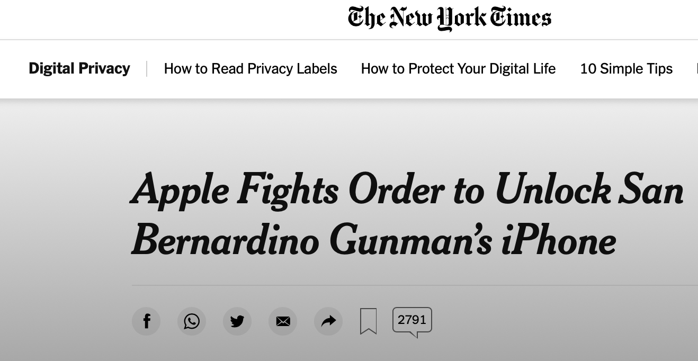




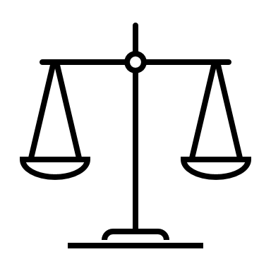
Tradeoffs with Security
Privacy
Security

Slide 23
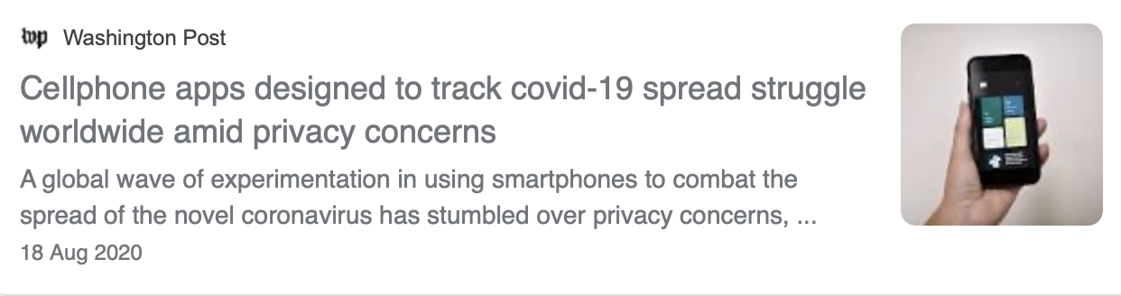


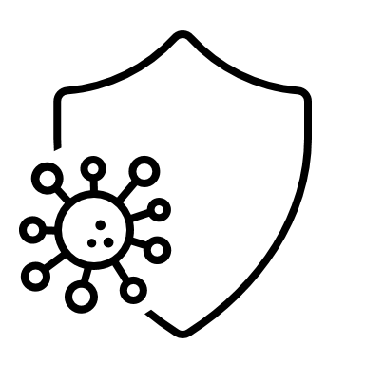
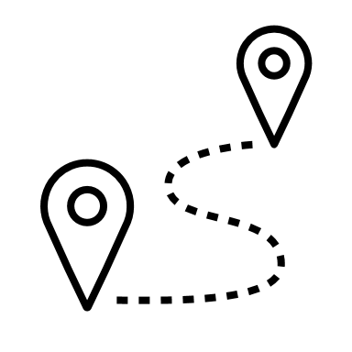
Tradeoffs with Public Health
Privacy
Public Health

Slide 24
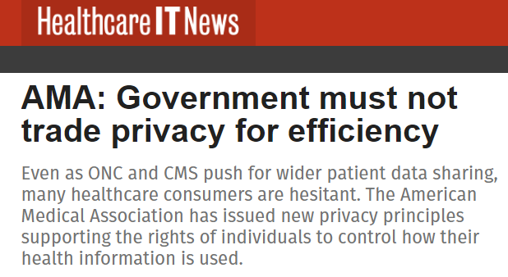

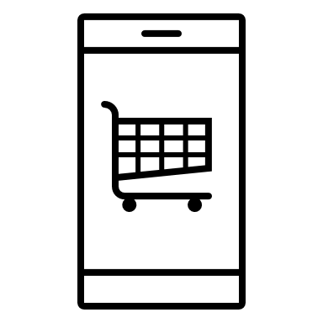

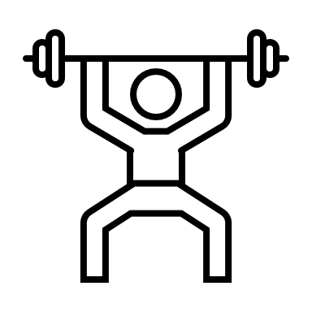
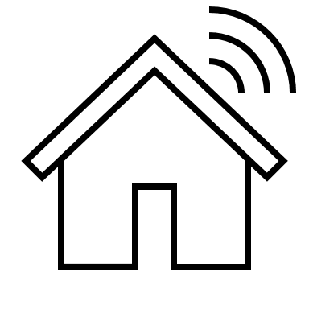
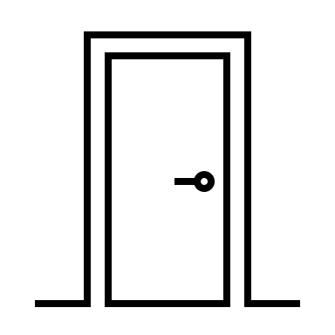
Tradeoffs with Convenience and Efficiency
Privacy
Convenience/ Efficiency

Slide 25
Activity: Discussing Privacy Tradeoffs
Scenario: General discussion.
What limits to privacy should we accept for the sake of national security, public health, and the quality and efficiency of services?
In what contexts do you think privacy overrides other values?

Slide 26
Mitigate Privacy Risks
Topic D

Slide 27
Framework for Selecting Mitigation Strategies
Can we do without this data?
Can we protect this data?
Minimize Data Collection and Sharing
Protect Data
Opt-in and Consent
Do users meaningfully consent to the way we collect and use this data?

Slide 28
Minimization of Collecting and Sharing Private Data
Avoiding the collection and sharing of data that is not necessary for your stated purposes.
What is necessary?
What about sharing with other organizations?

Slide 29



Determination of What Private Data Needs to Be Collected
What is necessary is not clear-cut. Rather, applying the criteria requires making ethical judgment calls.
Product teams know that features of products often change over time.
There is sometimes a tradeoff between minimizing the collection of personal data and fair treatment.

Slide 30
Protection of User Data
Protecting user data requires that organizations should make use of state-of-the-art techniques for protecting personal information.
Techniques can vary, but have three main focuses:
Anonymization: Remove data that may identify a subject.
01
Encryption: Protect information from access by unauthorized people.
02
Zero-knowledge protocols: Share relevant information without revealing user data.
03

Slide 31
Anonymization
Anonymization: The process of permanently removing data points that might be used to identify a subject.
Pseudo-anonymization: The process of disguising data that might identify a subject.
Anonymized data is less likely to be traced back to an individual.
Reduces risks to privacy.
Be aware of information combinations that might negate anonymization.
Be aware of information that could be revealed if the anonymized data is combined with other data sources.

Slide 32
Encryption
Encryption: Protecting information from access by unauthorized people.
Homomorphic encryption: A technique to analyze and manipulate data while it is still encrypted.
Encryption of data at rest and in transit:
At rest: Algorithm and key required to encode and decode messages.
In transit: VPNs can hide IP addresses, other identifiable information for network traffic.
In transit: Proxies act similarly for web traffic.
Homomorphic encryption:
Only the results are decrypted.
Enables you to work on data without sharing it in its unencrypted form.
Encryption now a standard requirement in privacy regulation and standards.
Use the latest encryption techniques wherever available.
Reduces the risk of data being exposed inadvertently.
Data that cannot be decrypted in any way is useless.
Any point where unencrypted data is processed is an attack vector.

Slide 33
Zero-Knowledge Protocols
Zero-knowledge protocols: Encryption protocols that enable you to prove you have information about something without revealing the actual information you possess.
Communicate about personal data without revealing the actual data.
Use to prove income level without sharing bank statements.
Useful for transferring relevant information to third parties while minimizing the exposure of private user data.
Be aware that sometimes third parties require less sensitive information about a user than the organization would need to share as proof.

Slide 34
Opt-In and Consent
Informed consent: Consent given based on a clear appreciation and understanding of the facts, implications, and consequences of an action.
Organizations ask for consent about data collection and use.
What data is collected, and how is the data used?
Insufficient comprehension and willingness in the consent process for users to give informed consent.
Alternative approach after other avenues have been explored.
Organizations request users accept a data sharing agreement.
Live up to high ethical standards like minimizing data collection and data protection.
Ask for consent in a way that gives users agency about what happens with their data.
Connect to the framework for an ethics risk assessment.

Slide 35
Strategies for Obtaining Informed Consent
Strategy | Description
Explain | Give short explanations of how data is collected and used in plain language.
Verify | Verify that users understand what you are saying, perhaps using a short knowledge check.
Point out | Point out the privacy risks you identified.
Set defaults | Set defaults that minimize data collection, even at the expense of product quality, and allow users to select more permissive settings to unlock additional functionality.
Renew | Renew consent agreements regularly and give users the possibility to dial back data collection and sharing on an ongoing basis.

Slide 36
Activity: Discussing Privacy Risk Mitigation
Scenario: Consider the RudiBrace product, or a product you are working on in your own company.
Consider two privacy risks associated with the product and ways of mitigating these risks.
Which tradeoffs do these mitigation strategies create?

Slide 37
Have you or your company been involved in a privacy breach? If so, what steps were taken to mitigate the risks?
Which privacy tradeoffs do you think are most important, and why?

